Slide 1
Chapter 4
Enhanced Interior Gateway Routing Protocol (EIGRP)

Slide 2
EIGRP concepts
Understanding basics of EIGRP
Why we choose EIGRP?
EIGRP tables and terminology
EIGRP packet types
EIGRP metric calculation

Slide 3
EIGRP
EIGRP is cisco proprietary protocol w/c is developed by cisco systems w/c can be used only on cisco routers.
It is an example of hybrid protocol w/c has the properties of distance vector and link state routing protocol.
An advanced dynamic routing protocol used for routing decisions and configuration on the routers.
It sends only incremental updates, reducing the workload on the router and the amount of data that needs to be transmitted.
AD=90 internal, when routers are connected on the same AS.
AD=170 external, when routers are connected in different AS or different routing protocol.
Support classless routing
Support automatic & manual summarization on an enabled interface

Slide 4
EIGRP uses Diffusing Update Algorithm (DUAL)-to choose the best path from the source to the destn.
Support for VLSM & CIDR
Use 224.0.0.10 multicast address for EIGRP routers update
Support authentication (plain & MD5)
Provides routing support for different routing protocols (IP, IPX, Apple Talk and even IPv6)
EIGRP has three conditions that must be met for neighborship establishment.
Neighbor routers should be in the same subnet
AS should match
Identical values should match
Default hop count =100
Support load balancing over maximum 32 equal cost path, by default is 4 and un-equal cost path

Slide 5
Why you would choose to use EIGRP b/c of
backup routes (fast convergence/ dual)
Simple configuration
Flexibility in summarization
Unequal cost load balancing
Combine best of distance vector and link state
Supports multiple network routed protocols
EIGRP tables
A router running EIGRP maintains three tables
Topology table-the “show ip eigrp neighbor” command lists the information about neighbor routers
Neighbor table-------------use ”show ip eigrp topology”
Routing table--------use “show ip route eigrp”

Slide 6
Terms
Feasible distance—total distance (path) to a remote network, it is the best metric along all paths to a remote network.
Example 5632/5376 here 5632 is the FD
Reported/Advertised distance- is the distance from neighbor router to destination. From the above 5376 is the AD. Distance to neighbors
Active route—means the router is actively trying to find out a route for the destination, if the successor fails.
Passive route---it means that that router has backup route.
Successor =primary path=best route to a remote network. It is used by eigrp to forward a traffic to a destn & is stored in the routing table
Feasible successor = backup path (backup route). A path whose reported distance is less than the FD.
To be considered as feasible successor the AD must be less than the FD of the successor.

Slide 7
EIGRP packet types
Hello--------used to keep alive between the routers
Update---used to send route information to the neighbor routers
Query---used for requesting specific route information. Queries are multicast.
Replay---respond to a query to indicate to the source router that it does not need to into an active state b/c it has feasible successors to a destination network. Replies are unicast. An ack is sent for a reply packet.
Acknowledge= acknowledge the update, query and replay packets. Ack is always unicast. Ack is not sent for the hello and ack packet.

Slide 8
Understanding EIGRP metric calculation
Bandwidth (k1)- by deafualt is set 1
Delay(k3)—default 1
Reliability----(k4 &k5)—default 0
Loading (k2)-----default is set 0
MTU
Metric= (k1 * BW+ (k2* BW)/(256-load)) + k3*delay *(k5/(reliability+k4))
Default metric=256(BW + delay)
EIGRP metric calc uses 5 parameters k1-k5 values
K values act as multipliers or modifiers

Slide 9
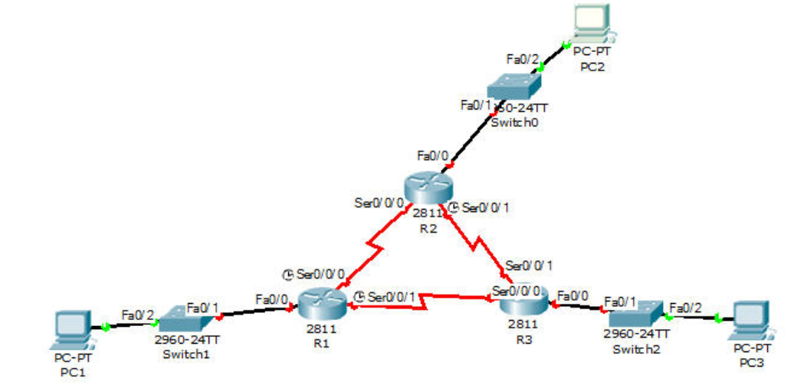

Slide 10
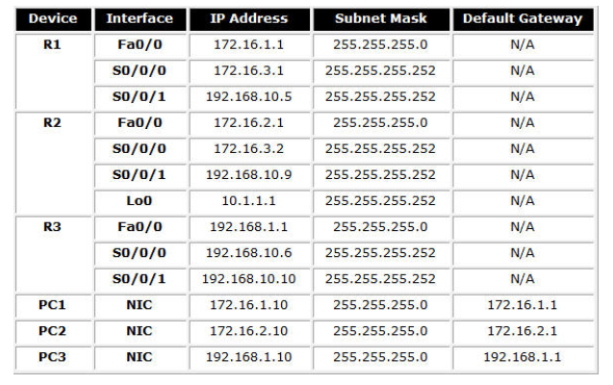

Slide 11
Route Redistribution
Enabling communication between different subnets which have different routers running different routing protocols.

Slide 12
Route Redistribution
Redistribution is the process of exchanging routing information between different routing protocols.
When we take a route from one routing protocol and inject or distribute it into another routing protocol called redistributed.
Routers by default only advertise and share routing information with other routers, running the same protocol and in the same AS.
Example if you have two routers R1 and R2, if R1 runs EIGRP and R2 runs OSPF and if you want to know them to each other’s routes by default these routers (R1 & R2 )do not share route information.
b/c they are not running on the same protocol.
Here we need redistribution to know R1 and R2 to each other.
Internal routes are routes advertised on the same protocol
External routes are routes w/c get redistributed.

Slide 13
Redistribution…..
To configure redistribution router must be running both protocols.
Change metric
RIPv2-----hop counts
OSPF -----cost
EIGRP-----BW+delay+load+mtu+reliability

Slide 14
Route redistribution
To do route redistribution there are 3 main steps you should follow.
Configure the router interfaces
Enable routing protocols in each routers and configure those routing protocols based on the given topology or scenario.
Now use redistribution on the core router to be redistributed to each other and able to communicate
Note: the core router must run both the protocols

Slide 15
Configuration to enable redistribution among ripv2, eigrp and ospf
To put eigrp and ospf inside ripv2
Router(config)#router rip
Router(config-router)#redistribute ospf 10 metric 1
Router(config-router)#redistribute eigrp 12 metric 1
Router(config-router)#exit
To put rip and eigrp inside of ospf
Router(config)#router ospf 10
Router(config-router)#redistribute rip subnets
Router(config-router)#redistribute eigrp 12 subnets
To put rip and and ospf inside eigrp
Router(config)#router eigrp 12
Router(config-router)#redistribute rip metric 10000 100 255 1 1500
Router(config-router)#redistribute ospf 10 metric 10000 100 255 1 1500

Slide 16
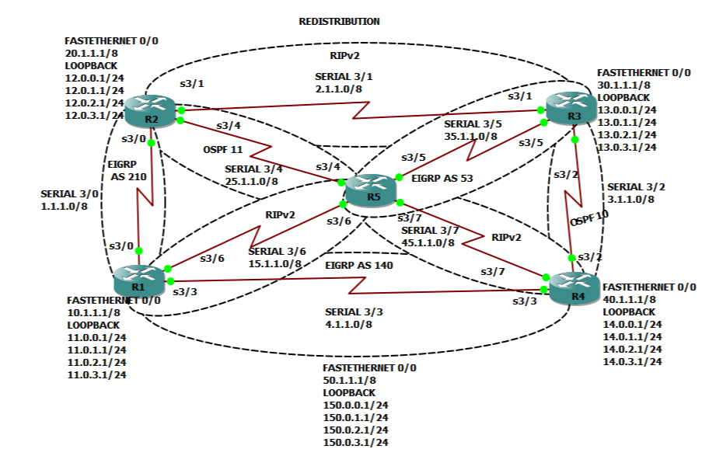
H/work
Draw the topology
Add 1 pc to r1, r2, r3, r4
R5 is the core router
Configure routing protocols
Configure route redistribution based on the scenario

